Slide 1


BrainPath Architecture & Implementation
Relational Database Design and Backend Pipeline
Group 9

Slide 2

PROJECT ROADMAP & DELIVERABLES
01
02
03
04
05
01
02
03
04
05
Data Elements
Conceptual Design
ER Diagram
DB & Backend
Full-Stack Link
→
→
→
→
Granular user attributes & academic metrics
Relational model blueprint & 3NF normalisation
Entity dependencies, constraints & cardinalities
PostgreSQL schemas & Express API server
Type-safe React frontend data wiring

Slide 3



1. DATA ELEMENTS & CORE ENTITIES
User Credentials
Student Metrics
Curriculum Data
Secure identity variables including encrypted password hashes and administrative roles.
Performance vectors like cumulative study hours, completion rates, and daily streaks.
Course artifacts, module keys, and lesson-level tracking parameters.
Event Metadata
Engagement Logs
Temporal events including quizzes, lectures, and task-specific deadlines.
User activity distributions mapped across the weekly calendar for trend analysis.

Slide 4
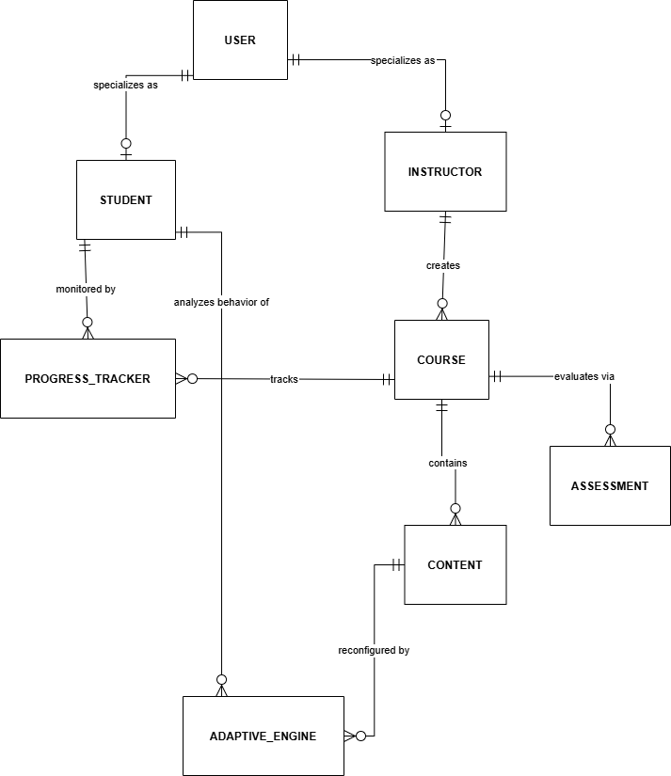
2. CONCEPTUAL RELATIONAL MODELING
Normalization & Performance
3NF Compliance: We architected the schema following 3rd Normal Form rules to eliminate data redundancy and ensure transactional integrity.
Decoupled Tables: Volatile metrics (e.g., login streaks) are separated from core user info to optimize query speeds and storage efficiency.
Access Control: Logic-level separation of Student and Instructor roles for secure dashboard routing.

Slide 5
SYSTEM RELATIONSHIP LOGIC
Relationship Path | Cardinality | Engineering Context
Users → Students | 1 : (0...1) | Mandatory unique profile link per account.
Instructors → Courses | 1 : N | One primary owner for multiple learning modules.
Students ↔ Courses | M : N | Resolved via specialized Enrollment junction tables.
Courses → Assessment | 1 : N | Sequential quizzes tied to a singular course ID.
Content → Adaptive Rules | 1 : N | Data artifacts processed by recommendation engines.
* Standard Crow's Foot notation was used to establish these relational constraints.

Slide 6
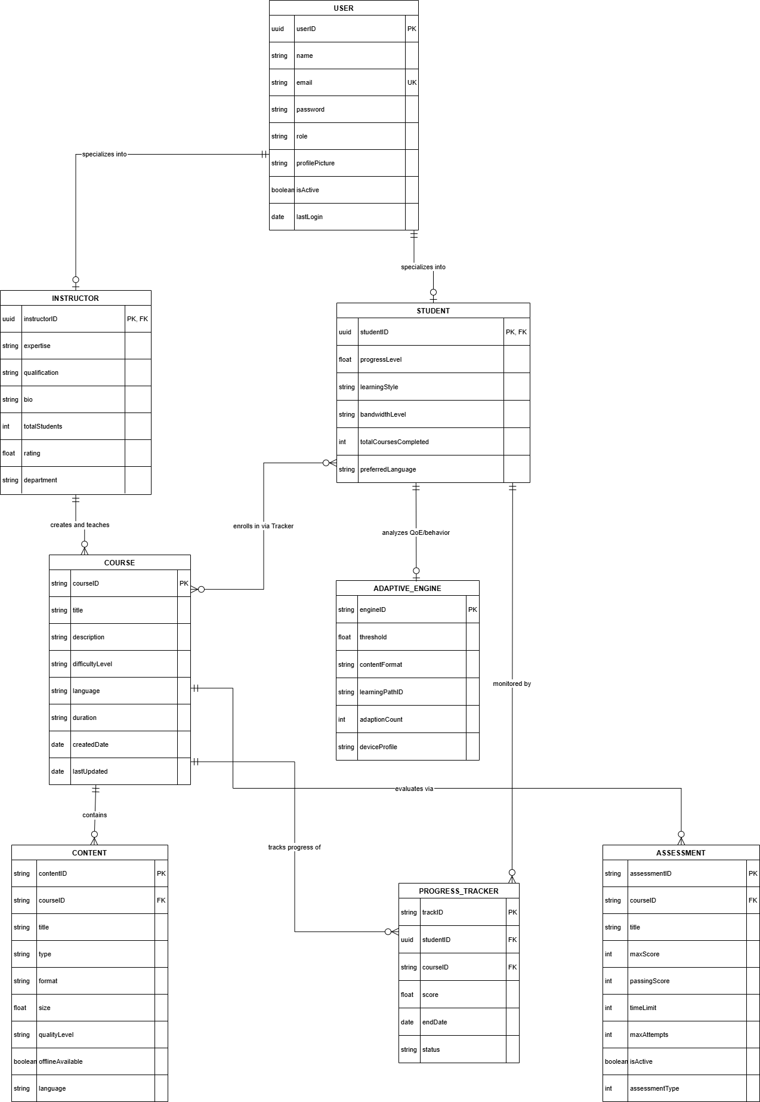
3. ER ARCHITECTURE & IDENTITY
UUID Identity Strategy: We utilize Universally Unique Identifiers (UUID) for primary keys instead of integers to enhance security and prevent record prediction.
Referential Integrity: Implemented ON DELETE CASCADE for profile metrics to ensure automatic cleanup of dependent student data.
Junction Tables: Efficient mapping of student progress across courses using high-speed modules lookup tables.

Slide 7

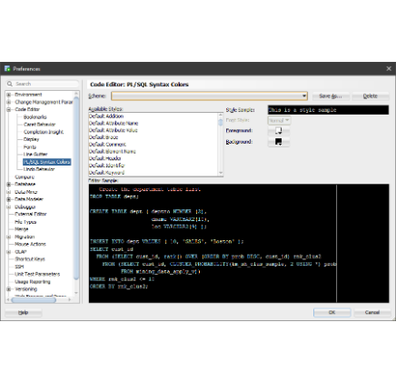
4. PHYSICAL DATABASE EXECUTION
Safe Schema Engineering
Enum Constrained Types: Deployed custom enumerated types directly in the DB engine to prevent illegal data entry at the source.
Safe Migrations: Developed idempotent SQL scripts (IF NOT EXISTS) to allow continuous updates without data loss.
Record Bootstrapping: Automated procedures to initialize study metrics immediately upon user registration.

Slide 8
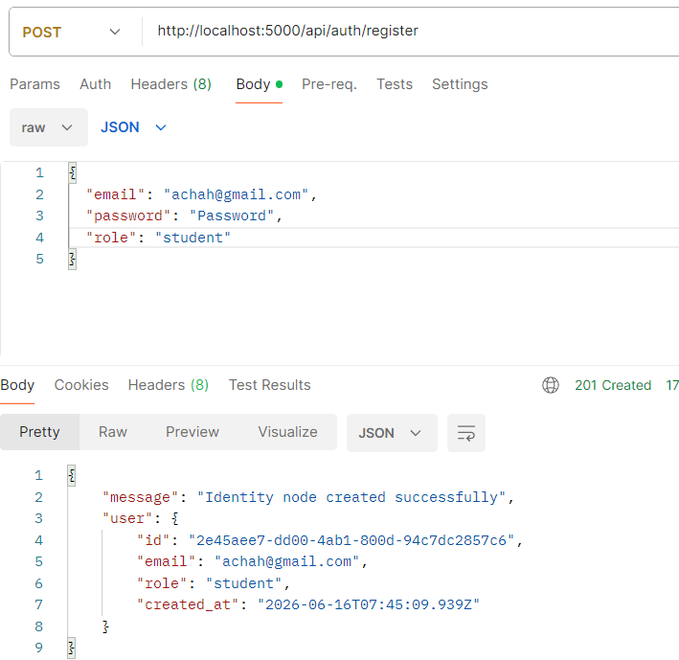
5. BACKEND PIPELINE & EXPRESS APIS
API Logic & Security
Connection Pooling: Configured pg-pool to manage database connections efficiently under heavy user load.
Authentication Guards: Middleware layer decrypts Bearer tokens to verify user permissions before data access.
JSON Payloads: Optimized API endpoints aggregate complex data (profile, charts, events) into single, predictable response objects.

